Slide 1
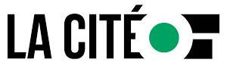
Traçage d'exécution
025948 - Diagnostiques de compilation, techniques de débogage
Steve Fotso
025914 - Assurance de qualité logicielle

Slide 2
Introduction
Comme nous l’avons vu dans le cours précédent, les erreurs de logique sont les plus difficiles à trouver et corriger.
Les erreurs de logique sont couramment appelées des bug
Le débogage est donc un processus de parcours du code pour trouver des bugs ou identifier des problèmes.
C’est aussi la capacité de vérifier l’état d’une variable, d’une classe or de ses membres à travers le programme
Le débogueur est le programme qu’on utilise pour débugger notre code
Pour ce cours nous allons parcourir les options et opérations de débogage de Visual Studio
Notes:
The consequences of these can prove to be extremely frustrating and expensive:
The general perception of the quality of the output begins to deteriorate as the team spends more and more time in fixing bugs than in actually creating new features
In extreme cases, adding features becomes virtually impossible with seemingly unrelated parts of the system failing due to the addition of a feature or, worse – fixing an earlier bug
Costs of adding features increases at an alarming rate with each delivery cycle
Adding more people becomes difficult, as they take a long time to come up to speed; sometimes, new team members are blatantly scared to touch large parts of the code, due to the fear of failure
Customer complaints increase, putting intense pressure to write an even worse code – to keep fixing the issues quickly

Slide 3
Commencer une opération de débogage
Il y’a plusieurs façons de commencer une opération de débogage
En appuyant F5
En faisant un clique droit sur le nom du projet suivi d’un clique sur ‘Step Into New Instance’ ou sur ‘start debugging’
En cliquant sur Debug – Start Debugging dans le menu principal (sur mac c’est Run – Start debugging.
En cliquant sur le bouton vert ci-dessous
Notes:
The consequences of these can prove to be extremely frustrating and expensive:
The general perception of the quality of the output begins to deteriorate as the team spends more and more time in fixing bugs than in actually creating new features
In extreme cases, adding features becomes virtually impossible with seemingly unrelated parts of the system failing due to the addition of a feature or, worse – fixing an earlier bug
Costs of adding features increases at an alarming rate with each delivery cycle
Adding more people becomes difficult, as they take a long time to come up to speed; sometimes, new team members are blatantly scared to touch large parts of the code, due to the fear of failure
Customer complaints increase, putting intense pressure to write an even worse code – to keep fixing the issues quickly

Slide 4
Terminer une opération de débogage
Pour terminer une opération de débogage,
Cliquer sur Debug – Stop Debugging dans le menu principal (sur mac c’est Run – Stop debugging.
Cliquer sur bouton d’arrêt de débogage
Notes:
The consequences of these can prove to be extremely frustrating and expensive:
The general perception of the quality of the output begins to deteriorate as the team spends more and more time in fixing bugs than in actually creating new features
In extreme cases, adding features becomes virtually impossible with seemingly unrelated parts of the system failing due to the addition of a feature or, worse – fixing an earlier bug
Costs of adding features increases at an alarming rate with each delivery cycle
Adding more people becomes difficult, as they take a long time to come up to speed; sometimes, new team members are blatantly scared to touch large parts of the code, due to the fear of failure
Customer complaints increase, putting intense pressure to write an even worse code – to keep fixing the issues quickly

Slide 5
Les fenêtres de débogage
Les fenêtres les plus utilisé durant le débogages sont:
La fenêtre locale
La fenêtre immédiate
La fenêtre de surveillance(watch)
La fenêtre du fil d appel
Notes:
The consequences of these can prove to be extremely frustrating and expensive:
The general perception of the quality of the output begins to deteriorate as the team spends more and more time in fixing bugs than in actually creating new features
In extreme cases, adding features becomes virtually impossible with seemingly unrelated parts of the system failing due to the addition of a feature or, worse – fixing an earlier bug
Costs of adding features increases at an alarming rate with each delivery cycle
Adding more people becomes difficult, as they take a long time to come up to speed; sometimes, new team members are blatantly scared to touch large parts of the code, due to the fear of failure
Customer complaints increase, putting intense pressure to write an even worse code – to keep fixing the issues quickly

Slide 6
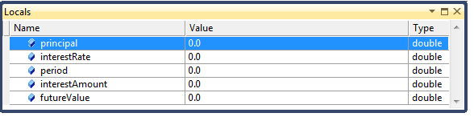
La fenêtre locale
La fenêtre locale est la plus utilisée durant le débogage.
Elle permet de voir la valeur contenue dans une variable au fur à mesure que celle ci change.(Valeur par défaut ou initial au début du débogage)
Pour l’afficher on peut faire Ctrl + Alt + V, relâcher et puis appuyer sur L
On peut aussi cliquer sur le menu principal, puis Debug – Windows – Locals
Sur mac c’est menu principal - View – Debug Windows – Locals
Notes:
The consequences of these can prove to be extremely frustrating and expensive:
The general perception of the quality of the output begins to deteriorate as the team spends more and more time in fixing bugs than in actually creating new features
In extreme cases, adding features becomes virtually impossible with seemingly unrelated parts of the system failing due to the addition of a feature or, worse – fixing an earlier bug
Costs of adding features increases at an alarming rate with each delivery cycle
Adding more people becomes difficult, as they take a long time to come up to speed; sometimes, new team members are blatantly scared to touch large parts of the code, due to the fear of failure
Customer complaints increase, putting intense pressure to write an even worse code – to keep fixing the issues quickly

Slide 7
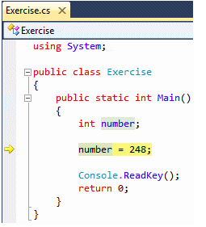
Exécuter une instruction à la fois
C’est la technique de base pour déboger, car elle permet de voir les résultats ligne après ligne, grâce au stepping info
Activé en cliquant sur Debug puis Step Into ou Run puis Step Into sur mac
Appuyer sur F11
Notes:
The consequences of these can prove to be extremely frustrating and expensive:
The general perception of the quality of the output begins to deteriorate as the team spends more and more time in fixing bugs than in actually creating new features
In extreme cases, adding features becomes virtually impossible with seemingly unrelated parts of the system failing due to the addition of a feature or, worse – fixing an earlier bug
Costs of adding features increases at an alarming rate with each delivery cycle
Adding more people becomes difficult, as they take a long time to come up to speed; sometimes, new team members are blatantly scared to touch large parts of the code, due to the fear of failure
Customer complaints increase, putting intense pressure to write an even worse code – to keep fixing the issues quickly

Slide 8
Exécuter une méthode à la fois
Le step into(F11) est une technique utile pour vérifier le comportement des variables dans les méthodes et s’assurer que la fonction fait ce dont à quoi on s’attend
Une fois qu’on sait que la fonction fait bien l’action qu’elle promet, on peut la sauter en utilisant le step over(Debug puis Step Over ou Run puis Step Over sur mac, F10)
Notes:
The consequences of these can prove to be extremely frustrating and expensive:
The general perception of the quality of the output begins to deteriorate as the team spends more and more time in fixing bugs than in actually creating new features
In extreme cases, adding features becomes virtually impossible with seemingly unrelated parts of the system failing due to the addition of a feature or, worse – fixing an earlier bug
Costs of adding features increases at an alarming rate with each delivery cycle
Adding more people becomes difficult, as they take a long time to come up to speed; sometimes, new team members are blatantly scared to touch large parts of the code, due to the fear of failure
Customer complaints increase, putting intense pressure to write an even worse code – to keep fixing the issues quickly

Slide 9
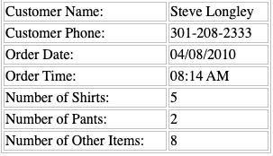
Exécuter le code jusqu’à un point
Cleaning order project – Entrer les valeurs suivantes
Amount tended 60
Notes:
The consequences of these can prove to be extremely frustrating and expensive:
The general perception of the quality of the output begins to deteriorate as the team spends more and more time in fixing bugs than in actually creating new features
In extreme cases, adding features becomes virtually impossible with seemingly unrelated parts of the system failing due to the addition of a feature or, worse – fixing an earlier bug
Costs of adding features increases at an alarming rate with each delivery cycle
Adding more people becomes difficult, as they take a long time to come up to speed; sometimes, new team members are blatantly scared to touch large parts of the code, due to the fear of failure
Customer complaints increase, putting intense pressure to write an even worse code – to keep fixing the issues quickly

Slide 10
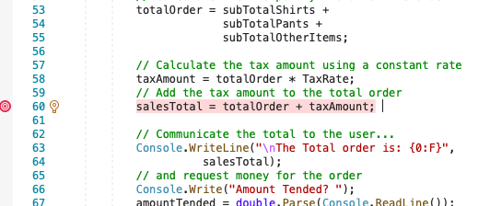
Les points d’arrêt
Les points d’arrêt sont des endroits dans le code ou on veut que l’exception s’arrête. On doit le créer physiquement (autant nécessaire)
Notes:
The consequences of these can prove to be extremely frustrating and expensive:
The general perception of the quality of the output begins to deteriorate as the team spends more and more time in fixing bugs than in actually creating new features
In extreme cases, adding features becomes virtually impossible with seemingly unrelated parts of the system failing due to the addition of a feature or, worse – fixing an earlier bug
Costs of adding features increases at an alarming rate with each delivery cycle
Adding more people becomes difficult, as they take a long time to come up to speed; sometimes, new team members are blatantly scared to touch large parts of the code, due to the fear of failure
Customer complaints increase, putting intense pressure to write an even worse code – to keep fixing the issues quickly

Slide 11
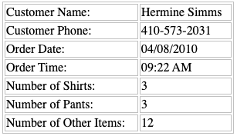
Les points d’arrêt (suite…)
Cleaning order project – Entrer les valeurs suivantes
Amount tended 100, breakpoint à la ligne 30 et 60
Notes:
The consequences of these can prove to be extremely frustrating and expensive:
The general perception of the quality of the output begins to deteriorate as the team spends more and more time in fixing bugs than in actually creating new features
In extreme cases, adding features becomes virtually impossible with seemingly unrelated parts of the system failing due to the addition of a feature or, worse – fixing an earlier bug
Costs of adding features increases at an alarming rate with each delivery cycle
Adding more people becomes difficult, as they take a long time to come up to speed; sometimes, new team members are blatantly scared to touch large parts of the code, due to the fear of failure
Customer complaints increase, putting intense pressure to write an even worse code – to keep fixing the issues quickly

Slide 12
Documentation Microsoft sur les techniques de debogage
Documentation
Notes:
The consequences of these can prove to be extremely frustrating and expensive:
The general perception of the quality of the output begins to deteriorate as the team spends more and more time in fixing bugs than in actually creating new features
In extreme cases, adding features becomes virtually impossible with seemingly unrelated parts of the system failing due to the addition of a feature or, worse – fixing an earlier bug
Costs of adding features increases at an alarming rate with each delivery cycle
Adding more people becomes difficult, as they take a long time to come up to speed; sometimes, new team members are blatantly scared to touch large parts of the code, due to the fear of failure
Customer complaints increase, putting intense pressure to write an even worse code – to keep fixing the issues quickly

